Slide 1
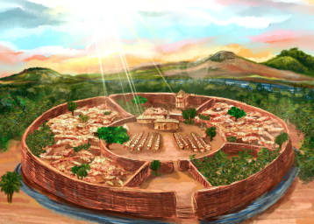
Curriculum Overview
Year 6 Summer 1: Benin Kingdom
Main Enquiry questions
Why do you think we should study Benin in KS2 history?
What sort of place was Benin 500 to 1,000 years ago?
What can we tell about Benin society at this time from the images and artefacts that have survived?
What changes took place when the European settlers started trading?
Why did the Victorians get involved in Benin and what were the effects on the Benin people?
Should the Benin Bronzes be returned?
This term’s driver topic is Benin Kingdom. We will be learning about Benin through looking at artefacts. We will also be discussing why the Victorians decided to take over.
Key Concepts
The following are the key concepts for this unit:
Recognise why people did things, recognise why some events happened, recognise what happened as a result of people’s actions or events.
Recognise and make simple observations about which places and which people were important in an historical event/account and why.
Maths Learning
This term in Maths we will be studying:
Statistics
Position and Direction
English Texts
This term in English we will be studying the following texts: The Midnight Panther by Poonam Mistry. We will be creating a narrative. We will also be reading The Boy in the Tower by Polly Ho-Yen. We will also be writing a narrative.
Geographical Links | Science | DT | PE | Music | RE | Computing | French | PSHE
Can you locate Benin on a map? How has Benin changed in the last 1,000 years? | Living things and their habitats. | ‘Mini homes’ | Football | Music and Me. | For Christians, what kind of king is Jesus? | Creating Media– 3D Modelling | Items of clothing | Safety and the changing body

Slide 2
Our curriculum elements for this half term:
Learning hook |  | We will be exploring Benin artefacts which we might have already seen before.
Fieldwork |  | Children will go on a hike through Newton Poppleford to explore the local area and to continue working on their maps skills.
Written outcome |  | Writing narratives.
Creative outcome |  | Children will be designing a ‘mini-home’ using a variety of materials.
Adventure (activities in Adventure Island) |  | In Adventure Island, we will be doing tree and flower hunts, bug hunts, pond dipping and planting in the allotment.
Play Project |  | We will be starting our play at the end of this half term!
Celebration |  | Children will display their ‘mini homes’ and be able to take them home at the end of the term.
Retrieval practice |  | Each lesson to begin with questions/quiz from previous lesson to retrieve knowledge.
Trips, activities and/or visits this term:
Exmoor Challenge walk for those taking part
Afternoon of celebration after SATs

Slide 3
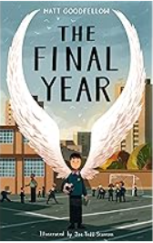
Suggested texts to read at home with your children
The Children of Benin Kingdom Dinah Orji | The Final Year Michelle Magorian
A fast-paced adventure, this story brings to life one of Africa’s most fascinating civilizations, the ancient Edo Kingdom of Benin. This is an immersive adventure story and perfect for any child who enjoys being transported to another world. It fits well with the increasing interest in African fiction and stories that are inclusive, diverse and explore a greater range of cultures, stories and settings. | This is powerful and lyrical story, told in verse, about finding your place in the world and the people that matter within it explores themes of family, identity, belonging, navigating friendships and the hardships of everyday life in a working class family in the North of England.
Curriculum Overview: Year 6 Summer 1
The Benin Kingdom
Week 1 | Week 2 | Week 3 | Week 4 | Week 5
Equip Equipment Equipped Especially Exaggerate Excellent Existence Explanation Familiar Foreign Forty frequently | Government Guarantee Harass Hindrance Identity Immediate Immediately Individual Interfere Interrupt Language Leisure | Assistance Assistant Confidence Confident Decency Decent Expectant Frequency Frequent Hesitancy hesitant | Lightning Marvellous Mischievous Muscle Necessary Neighbour Nuisance Occupy Occur Opportunity Parliament persuade | Practice Practise Prophecy Prophesy Stationary Stationery Steal Steel Wary Weary Who’s whose

